Slide 1
Chapter 3: Process Concept
Class #7
Process Concept
Process Scheduling
Operations on Processes
Cooperating Processes
Interprocess Communication

Slide 2

FreeBSD Running Multiple Programs

Slide 3
An Analogy
Example
  Various workers (males, females, skilled, unskilled, semi-skilled) are working on some job.
  Question: How to organize them effectively to improve the performance ?
  Sitting worker is similar to program.
    Does not use any tools and resources.
  Working worker is similar to process
    Uses tools, interacts with other,
    If he is working with others, cooperation and synchronization is required. Otherwise accidents might occur.
    If he is working alone, no cooperation is needed.
  To manage working workers, the manager should have some information about the working worker.
    What kind of tools he is using.
    The nature of the job, and status of the job.
    ….
  In computer system
    Operating system is similar to manager
    The sitting workers are similar to the programs reside on the disk.
    The working workers are processes
    CPU is an expensive tool which should not be kept idle. It is OK if some workers wait for expensive tool.

Slide 4
Process Concept
Early systems
  One program at a time was executed and a single program has a complete control.
Modern OSs allow multiple programs to be loaded in to memory and to be executed concurrently.
This requires firm control over execution of programs.
The notion of process emerged to control the execution of programs.
A process
  Unit of work
  Program in execution
OS consists of a collection of processes
  OS processes executes system code.
  User processes executes user code.
By switching CPU between processes, the OS can make the computer more productive.

Slide 5
Process Concept…
A program is simply a text
Process (task or job) includes the current activity.– a program in execution; process execution must progress in sequential fashion.
The components of a process are
  The program to be executed
  The data on which the program will execute
  The resources required by the program– such as memory and file (s)
  The status of execution
    program counter
    Stack
A program is a passive entity, and a process is an active entity with the value of the PC. It is an execution sequence.
Multiple processes can be associated with the same program (editor). They are separate execution sequences.
For CPU, all processes are similar
  Batch Jobs and user programs/tasks
  Word file
  Internet browser
  System call
  Scheduler
  ….

Slide 6
Process State
As a process executes, it changes state
Each process can be in one of
  new: The process is being created.
  running: Instructions are being executed.
  waiting: The process is waiting for some event to occur.
  ready: The process is waiting to be assigned to a process.
  terminated: The process has finished execution.
The names may differ between OSs.

Slide 7

Diagram of Process State

Slide 8
State change
Null → New : a new process is created to execute the program
  New batch job, log on
  Created by OS to provide the service
New → ready: OS will move a process from prepared to ready state when it is prepared to take additional process.
Ready → Running: when it is a time to select a new process to run, the OS selects one of the process in the ready state.
Running → terminated: The currently running process is terminated by the OS if the process indicates that it has completed, or if it aborts.
Running → Ready: The process has reached the maximum allowable time or interrupt.
Running → Waiting: A process is put in the waiting state, if it requests something for which it must wait.
  Example: System call request.
Waiting → Ready: A process in the waiting state is moved to the ready state, when the event for which it has been waiting occurs.
Ready → Terminated: If a parent terminates, child process should be terminated
Waiting → Terminated: If a parent terminates, child process should be terminated

Slide 9
Process Control Block (PCB)
Information associated with each process.
Process state: new, ready, running,…
PC: address of the next instruction to execute
CPU registers: includes data registers, stacks, condition-code information, etc
CPU scheduling information: process priorities, pointers to scheduling queues, etc.
Memory-management information: locations including value of base and limit registers, page tables and other virtual memory information.
Accounting information: the amount of CPU and real time used, time limits, account numbers, job or process numbers etc.
I/O status information: List of I/O devices allocated to this process, a list of open files, and so on

Slide 10

Process Control Block (PCB)

Slide 11

CPU Switch From Process to Process

Slide 12
Process Scheduling Queues
Scheduling is to decide which process to execute and when
The objective of multi-program
  To have some process running at all times.
Timesharing: Switch the CPU frequently that users can interact can interact with the program while it is running.
If there are many processes, the rest have to wait until CPU is free.
Scheduling is to decide which process to execute and when.
Scheduling queues:
  Job queue – set of all processes in the system.
  Ready queue – set of all processes residing in main memory, ready and waiting to execute.
  Device queues – set of processes waiting for an I/O device.
    Each device has its own queue.
Process migrates between the various queues during its life time.

Slide 13

Ready Queue And Various I/O Device Queues

Slide 14

Representation of Process Scheduling
A new process is initially put in the ready queue
Once a process is allocated CPU, the following events may occur
  A process could issue an I/O request
  A process could create a new process
  The process could be removed forcibly from CPU, as a result of an interrupt.
When process terminates, it is removed from all queues. PCB and
its other resources are de-allocated.

Slide 15
Schedulers
A process migrates between the various scheduling queues throughout its lifetime.
The OS must select a process from the different process queues in some fashion. The selection process is carried out by a scheduler.
In a batch system the processes are spooled to mass-storage device.
Long-term scheduler (or job scheduler) – selects which processes should be brought into the ready queue.
  It may take long time
Short-term scheduler (or CPU scheduler) – selects which process should be executed next and allocates CPU.
  It is executed at least once every 100 msec.
  If 10 msec is used for selection, then 9 % of CPU is used (or wasted)
The long-term scheduler executes less frequently.
The long-term scheduler controls degree of multiprogramming.
Multiprogramming: the number of processes active in the system.
If MPL is stable: average rate of process creation= average departure rate of processes.

Slide 16
Schedulers…
The long-term scheduler should make a careful selection.
Most processes are either I/O bound or CPU bound.
  I/O bound process spends more time doing I/O than it spends doing computation.
  CPU bound process spends most of the time doing computation.
The LT scheduler should select a good mix of I/O-bound and CPU-bound processes.
Example:
  If all the processes are I/O bound, the ready queue will be empty
  If all the processes are CPU bound, the I/O queue will be empty, the devices will go unutilized and the system will be imbalanced.
Best performance: best combination of CPU-bound and I/O-bound process.

Slide 17
Schedulers…
Some OSs introduced a medium-term scheduler using swapping.
  Key idea: it can be advantageous, to remove the processes from the memory and reduce the multiprogramming.
Swapping: removal of process from main memory to disk to improve the performance. At some later time, the process can be reintroduced into main memory and its execution can be continued when it left off.
Swapping improves the process mix (I/O and CPU), when main memory is unavailable.

Slide 18

Addition of Medium Term Scheduling

Slide 19
Context Switch
Context switch is a task of switching the CPU to another process by saving the state of old process and loading the saved state for the new process
Context of old process is saved in PCB and loads the saved context of old process.
Context-switch time is overhead; the system does no useful work while switching.
New structures threads were incorporated.
Time dependent on hardware support.
  1 to 1000 microseconds

Slide 20
Operations on Processes: process creation
A system call is used to create process.
  Assigns unique id
  Space
  PCB is initialized.
The creating process is called parent process.
Parent process creates children processes, which, in turn create other processes, forming a tree of processes.
  In UNIX pagedaemon, swapper, and init are children are root process. Users are children of init process.
A process needs certain resources to accomplish its task.
  CPU time, memory, files, I/O devices.
When a process creates a new process,
  Resource sharing possibilities.
    Parent and children share all resources.
    Children share a subset of parent’s resources.
    Parent and child share no resources.
  Execution possibilities
    Parent and children execute concurrently.
    Parent waits until children terminate.

Slide 21
Process Creation (Cont.)
  Address space
    Child duplicate of parent.
    Child has a program loaded into it.
UNIX examples
  fork system call creates new process
  exec system call used after a fork to replace the process’ memory space with a new program.
  The new process is a copy of the original process.
  The exec system call is used after a fork by one of the two processes to replace the process memory space with a new program.
DEC VMS
  Creates a new process, loads a specified program into that process, and starts it running.
WINDOWS NT supports both models:
  Parent address space can be duplicated or
  parent can specify the name of a program for the OS to load into the address space of the new process.

Slide 22
UNIX: fork() system call
fork() is used to create processes. It takes no arguments and returns a process ID.
fork() creates a new process which becomes the child process of the caller.
After a new process is created, both processes will execute the next instruction following the fork() system call.
The checking the return value, we have to distinguish the parent from the child.
fork()
  If returns a negative value, the creation is unsuccessful.
  Returns 0 to the newly created child process.
  Returns positive value to the parent.
Process ID is of type pit_t defined in sys/types.h
getpid() can be used to retrieve the process ID.
The new process consists of a copy of address space of the original process.

Slide 23
UNIX: fork() system call
  #include <stdio.h>
  #include <string.h>
  #include <sys/types.h>
  #define MAX_COUNT 200
  #define BUF_SIZE 100
  void main(void)
  {
  pid_t pid;
  int i;
  char buf[BUF_SIZE];
  fork();
  pid=getpid();
  for(i=1; i<=MAX_COUNT;i++)
  {
  sprintf(buf,”This line is from pid %d, value=%d\n”,pid,i);
  write(1,buf,strlen(buf));
  }
  }

Slide 24
UNIX: fork() system call
If the fork() is executed successfully, Unix will
  Make two identical copies of address spaces; one for the parent and one for the child.
  Both processes start their execution at the next statement after the fork().
Parent
Child
main()
{
fork();
pid=…;
}
main()
{
fork();
pid=…
}

Slide 25
UNIX: fork() system call
  #include <stdio.h>
  #include <sys/types.h>
  #define MAX_COUNT 200
  void ChildProcess(void);
  void ParentProcess(void);
  #define BUF_SIZE 100
  void main(void)
  {
  pid_t pid;
  pid=fork();
  if (pid==0)
  ChildProcess();
  else
  ParentProcess();
  }
  }
  Void ChildProcess(void)
  {
  int i;
  for(i=1;i<=MAX_COUNT;i++)
  {
  printf(buf,”This line is from child, value=%d\n”,i);
  Printf(“ *** Child Process is done ***\n”);
  }
  }
  Void ParentProcess(void)
  {
  int i;
  for(i=1;i<=MAX_COUNT;i++)
  {
  printf(buf,”This line is from parent, value=%d\n”,i);
  printf(“ *** Parent Process is done ***\n”);
  }
  }

Slide 26
UNIX: fork() system call
Parent
Child
  void main(void)
  {
  pid=fork();
  if (pid==0)
  ChildProcess();
  else
  ParentProcess();
  }
  }
  Void ChildProcess(void)
  {
  }
  Void ParentProcess(void)
  {
  }
PID=3456
  void main(void)
  {
  pid=fork();
  if (pid==0)
  ChildProcess();
  else
  ParentProcess();
  }
  }
  Void ChildProcess(void)
  {
  }
  Void ParentProcess(void)
  {
  }
PID=0

Slide 27

Processes Tree on a UNIX System

Slide 28
UNIX system initialization
bootstrap
process0
Swapper
Wait until init exits SYSTEM SHUTDOWN
fork
process1
Wait until all children exit
init
fork
exec
exec
getty
login
shell
fork
User
commands
..
.
.
As many as available
exit

Slide 29
Process Termination
Process executes last statement and asks the operating system to decide it (exit).
  Output data from child to parent (via wait).
  Process’ resources are deallocated by operating system.
Parent may terminate the execution of children processes (abort).
  Child has exceeded allocated resources.
  Task assigned to child is no longer required.
  Parent is exiting.
    Operating system does not allow child to continue if its parent terminates.
    Cascading termination.

Slide 30
Cooperating Processes
The processes can be independent or cooperating processes.
Independent process cannot affect or be affected by the execution of another process.
Cooperating process can affect or be affected by the execution of another process
Advantages of process cooperation
  Information sharing
  Computation speed-up
    Break into several subtasks and run in parallel
  Modularity
    Constructing the system in modular fashion.
  Convenience
    User will have many tasks to work in parallel
      Editing, compiling, printing

Slide 31
Inter-process Communication (IPC) or Pipe concept
IPC facility provides a mechanism to allow processes to communicate and synchronize their actions.
Processes can communicate through shared memory or message passing.
  Both schemes may exist in OS.
The Shared-memory method requires communication processes to share some variables.
The responsibility for providing communication rests with the programmer.
  The OS only provides shared memory.
Example: producer-consumer problem.

Slide 32
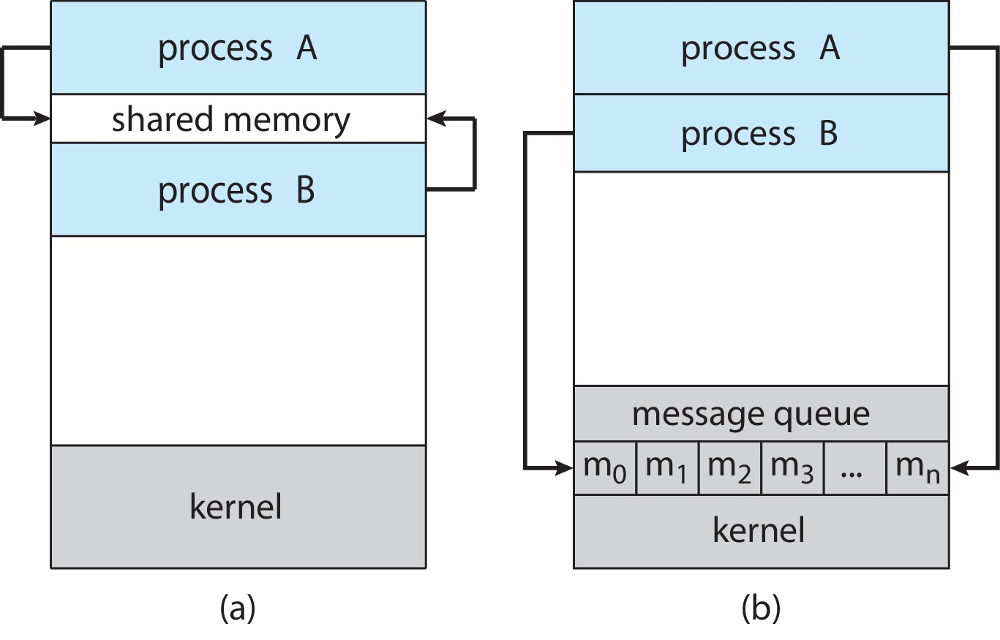
Communication Models
Shared Memory
Msg Passing

Slide 33
Inter-process communication in shared memory systems
Producer-Consumer Problem: Shared memory
Paradigm for cooperating processes, producer process produces information that is consumed by a consumer process.
  unbounded-buffer places no practical limit on the size of the buffer.
    Producer can produce any number of items.
    Consumer may have to wait
  bounded-buffer assumes that there is a fixed buffer size.

Slide 34
Bounded-Buffer – Shared-Memory Solution
Shared data
      #define BUFFER_SIZE 10
      Typedef struct {
      . . .
      } item;
      item buffer[BUFFER_SIZE];
      int in = 0;
      int out = 0;
in points to next free position.
out points to first full position.

Slide 35
Bounded-Buffer – Producer Process
item nextProduced;
while (1) {
/* Produce an item in nextProduced */
while (((in + 1) % BUFFER_SIZE) == out)
; /* do nothing */
buffer[in] = nextProduced;
in = (in + 1) % BUFFER_SIZE;
}

Slide 36
Bounded-Buffer – Consumer Process
item nextConsumed;
while (1) {
while (in == out)
; /* do nothing */
nextConsumed = buffer[out];
out = (out + 1) % BUFFER_SIZE;
/* Consume the item in nextConsumed */
}

Slide 37
Inter-process Communication (IPC) in
Message Passing Systems
Message system – processes communicate with each other without resorting to shared variables.
If P and Q want to communicate, a communication link exists between them.
OS provides this facility.
IPC facility provides two operations:
  send(message) – message size fixed or variable
  receive(message)
If P and Q wish to communicate, they need to:
  establish a communication link between them
  exchange messages via send/receive
Implementation of communication link
  physical (e.g., shared memory, hardware bus)
  logical (e.g., logical properties)
    We are concerned with logical link.

Slide 38
Fixed and variable message size
Fixed size message
  Good for OS designer
  Complex for programmer
Variable size messages
  Complex for the designer
  Good for programmer

Slide 39
Methods to implement a link
Direct or Indirect communication
Synchronous or asynchronous communication
Automatic or explicit buffering

Slide 40
Direct Communication
Processes must name each other explicitly:
  send (P, message) – send a message to process P
  receive(Q, message) – receive a message from process Q
Properties of communication link
  Links are established automatically.
  A link is associated with exactly one pair of communicating processes.
  Between each pair there exists exactly one link.
  The link may be unidirectional, but is usually bi-directional.
This exhibits both symmetry and asymmetry in addressing
  Symmetry: Both the sender and the receiver processes must name the other to communicate.
  Asymmetry: Only sender names the recipient, the recipient is not required to name the sender.
    The send and receive primitives are as follows.
      Send (P, message)– send a message to process P.
      Receive(id, message)– receive a message from any process.
Disadvantages: Changing a name of the process creates problems.

Slide 41
Indirect Communication
The messages are sent and received from mailboxes (also referred to as ports).
A mailbox is an object
  Process can place messages
  Process can remove messages.
Two processes can communicate only if they have a shared mailbox.
Operations
  create a new mailbox
  send and receive messages through mailbox
  destroy a mailbox
Primitives are defined as:
send(A, message) – send a message to mailbox A
receive(A, message) – receive a message from mailbox A

Slide 42
Indirect Communication
Mailbox sharing
  P₁, P₂, and P₃ share mailbox A.
  P₁, sends; P₂ and P₃ receive.
  Who gets a message ?
Solutions
  Allow a link to be associated with at most two processes.
  Allow only one process at a time to execute a receive operation.
  Allow the system to select arbitrarily the receiver. Sender is notified who the receiver was.
Properties of a link:
  A link is established if they have a shared mailbox
  A link may be associated with more than two boxes.
  Between a pair of processes they may be number of links
  A link may be either unidirectional or bi-directional.
OS provides a facility
  To create a mailbox
  Send and receive messages through mailbox
  To destroy a mail box.
The process that creates mailbox is a owner of that mailbox
The ownership and send and receive privileges can be passed to other processes through system calls.

Slide 43
Indirect Communication
Messages are directed and received from mailboxes (also referred to as ports).
  Each mailbox has a unique id.
  Processes can communicate only if they share a mailbox.
Example:
Producer process:
    repeat
    ….
    Produce an item in nextp
    …
    send(consumer,nextp);
    until false;
Consumer process
  repeat …. receive(producer, nextc);…. Consume the item in nextc … until false;

Slide 44
Synchronous or asynchronous
Message passing may be either blocking or non-blocking.
Blocking is considered synchronous
Non-blocking is considered asynchronous
send and receive primitives may be either blocking or non-blocking.
  Blocking send: The sending process is blocked until the message is received by the receiving process or by the mailbox.
  Non-blocking send: The sending process sends the message and resumes operation.
  Blocking receive: The receiver blocks until a message is available.
  Non-blocking receive: The receiver receives either a valid message or a null.

Slide 45
Automatic and explicit buffering
A link has some capacity that determines the number of messages that can reside in it temporarily.
Queue of messages is attached to the link; implemented in one of three ways.
  1. Zero capacity – 0 messages
  Sender must wait for receiver (rendezvous).
  Bounded capacity – finite length of n messages
  -Sender must wait if link full.
  Unbounded capacity – infinite length
  Sender never waits.
In non-zero capacity cases a process does not know whether a message has arrived after the send operation.
The sender must communicate explicitly with receiver to find out whether the later received the message.
Example: Suppose P sends a message to Q and executes only after the message has arrived.
Process P:
  send (Q. message) : send message to process Q
  receive(Q,message) : Receive message from process Q
Process Q
  Receive(P,message)
  Send(P,”ack”)

Slide 46
Exception conditions
When a failure occurs error recovery (exception handling) must take place.
Process termination
  A sender or receiver process may terminate before a message is processed. (may be blocked forever)
  A system will terminate the other process or notify it.
Lost messages
  Messages may be lost over a network
  Timeouts; restarts.
Scrambled messages
  Message may be scrambled on the way due to noise
  The OS will retransmit the message
  Error-checking codes (parity check) are used.

Slide 47
Communication in Client-Server systems (over a network)
Sockets
Remote Procedure Calls
Pipes

Slide 48
Sockets
A socket is defined as an endpoint for communication.
A pair of processes communicating over a network employees a pair of sockets– one for each process.
Socket: Concatenation of IP address and port
The socket 161.25.19.8:1625 refers to port 1625 on host 161.25.19.8
Servers implementing specific services listen to well-known ports
  telnet server listens to port 80
  ftp server listens to port 21
  http server listens to port 80.
The ports less than 1024 are used for standard services.
The port for a socket is an arbitrary number greater than 1024.
Socket creation is a system call
Communication consists between a pair of sockets.
  Connection-oriented sockets (TCP)
  Connectionless sockets (UDP)
  Will discuss in Lectures on Networking
Sockets provide a low level of communication: an unstructured stream of bytes

Slide 49

Socket Communication

Slide 50
Remote Procedure Calls
Remote procedure call (RPC) abstracts procedure calls between processes on networked systems.
Stubs – client-side proxy for the actual procedure on the server.
The client-side stub locates the server and marshals the parameters.
  Marshalling: Parameters must be marshaled into a standard representation.
  The server-side stub receives this message, unpacks the marshaled parameters, and performs the procedure on the server.
There are several issues
  Network errors
  Semantics: Local procedure call can fail and RPCs can fail and re-executed
  One way to address this problem
    Making server and receiver to follow exactly once semantics (Local procedure calls)
      that processing of messages will happen only once. It is difficult to implement in a distributed system.
    At most once semantics (Remote procedure calls)
      when sending a message from a sender to a receiver there is no guarantee that a given message will be delivered.
      Server will act and send ack and identify repeated messages. The client may send messages more than once until it receives ack.
  Binding issues: linking loading and execution
    Fixed or rendezvous
Applications: distributed file systems

Slide 51
Meaning of words
Exactly once semantics: Exactly-once as the name suggests, there will be only one and once message delivery. It difficult to achieve in practice.
At most once semantics: As the name suggests, at-most-once means the message will be delivered at-most once.

Slide 52
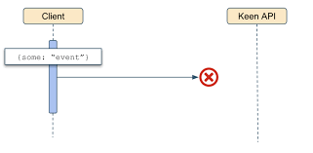
At-most-once Delivery
A message is delivered either one time only or not at all.
  Failure to deliver a message is typically due to a communication error or other disruption that causes consumers to not be able to handle an event.
  The key drawback of the at-most-once delivery scheme is that not all data will be captured which is often a disqualifier for data-sensitive applications.
At-most-once is ideal for applications that need high throughput and low latency due to the fire-and-forget nature. It is the default producer and consumer delivery semantic.
Example: Collecting sensor data

Slide 53
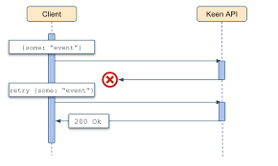
At-least-once Delivery
A message can be delivered one or more times, but will never be lost.
Duplication of events can occur due to the combination of disrupted communication and retrying events.
  This delivery semantic is ideal for applications where receiving every message is more important than having high throughput and low latency. The performance is limited due to needing to maintain state on the producer-side (not just fire-and-forget), waiting on acknowledgement from the brokers, and potentially having to retry if an event is not received. This also results in higher cost and implementation overhead than the at-most-once delivery configuration.
At-least-once is an extremely common delivery semantic across use cases, where duplication of data is acceptable, including many analytics.

Slide 54
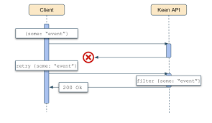
Exactly-once Delivery
A message will always be delivered only one time. With this configuration, a message cannot be dropped nor duplicated.
  Exactly-once delivery is typically achieved by filtering out duplicate events which requires maintaining state on the consumer-side in addition to the producer-side like in at-least-once configuration.
Because of this, exactly-once carries the highest implementation overhead and highest cost as well as potentially the worst performance of all of the delivery semantics.
Exactly-once delivery is the only configuration that can guarantee no events will be missed or duplicated.

Slide 55

Execution of RPC

Slide 56
Pipes
Pipe: another IPC mechanism
  uses the familiar file interface
  not a special interface (like messages)
Connects an open file of one process to an open file of another process
  Often used to connect the standard output of one process to the standard input of another process

Slide 57
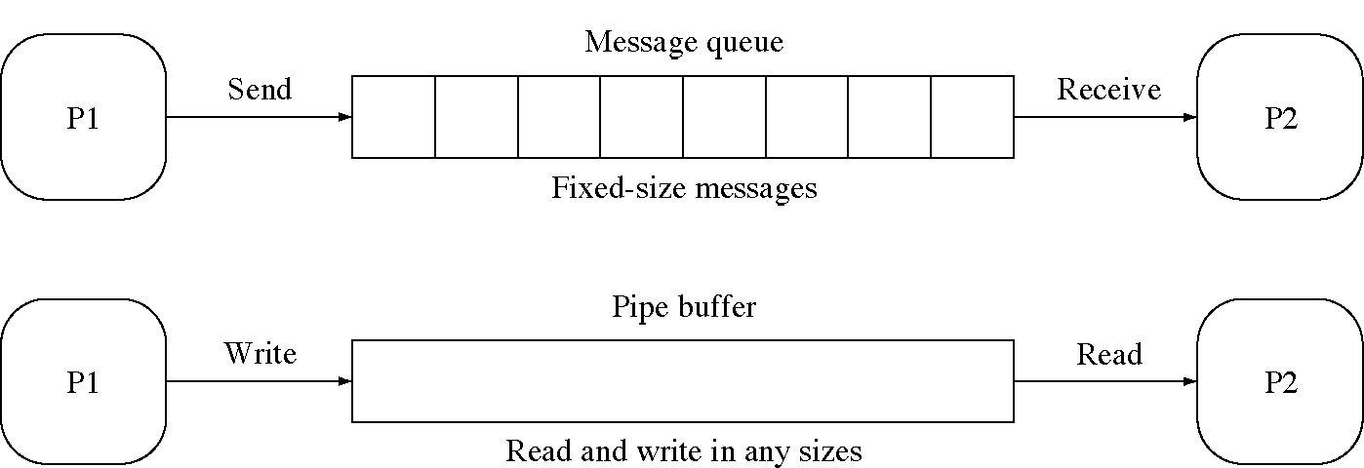
Messages and pipes compared

Slide 58
More about Pipes
Acts as a conduit allowing two processes to communicate
Issues
  Is communication unidirectional or bidirectional?
  In the case of two-way communication, is it half or full-duplex?
  Must there exist a relationship (i.e. parent-child) between the communicating processes?
  Can the pipes be used over a network?

Slide 59
Ordinary Pipes
Ordinary Pipes allow communication in standard producer-consumer style
Producer writes to one end (the write-end of the pipe)
Consumer reads from the other end (the read-end of the pipe)
Ordinary pipes are therefore unidirectional
Require parent-child relationship between communicating processes
Ordinary pipe can not be accessed from outside the process that creates it.
Pipe is a special type of file.

Slide 60

Ordinary Pipes
Unix function to create pipes: pipe(int fd[])
fd[0] is the read end. fd[1] is write end.

Slide 61
Named Pipes
Named Pipes are more powerful than ordinary pipes
Communication is bidirectional
No parent-child relationship is necessary between the communicating processes
Several processes can use the named pipe for communication
Provided on both UNIX and Windows systems

Slide 62
Pipes in Practice
ls | more

